Slide 1
Chapter 4: Threads

Slide 2
Chapter 4: Threads
Overview
Multithreading Models
Thread Libraries
Threading Issues
Operating System Examples
Windows XP Threads
Linux Threads

Slide 3
Overview
Thread: basic unit of CPU utilization.
It consists of thread id, program counter, register set, stack.
Traditional/heavyweight process has single thread of control.
If process has multiple threads of control, it can perform more than one task at a time, here it shares its code, data and other resources with other threads belonging to same process.

Slide 4
Motivation
Web browser may have one thread to display image or text and other thread to retreive network information.
In some cases application may have to do several similar tasks.
Server will have many client requests concurrently.
If we use single threaded process, it will serve only one client at a time, other clients have to wait enormously.

Slide 5
Contd…
Solution:
Server runs as single process that accepts the requests.
When a request comes from a client it creates a separate process to service that request which is time consuming.
So when a new client request comes server creates a new thread to service that request.
Many OS kernels are multithreaded, several threads operate in kernel, each thread performs specific task like managing devices, interrupt handling etc.

Slide 6

Multithreaded Server Architecture

Slide 7
Benefits of multithreaded programming
1)Responsiveness: multithreading on interactive application allows program to continue evenif part of it is blocked or performing lenghthy operation.
eg:if one thread is loading image then it allows user interation with browser in another thread.
2)Resource Sharing: threads share memory and resources of process to which they belong. Benefit of sharing code and data allows application to have several threads in same address space.
3)Economy: It is costly to create , manage ,allocating memory,resources for processes than threads.

Slide 8
Contd..
4)Utilization of multiprocessor architecture:
Multithreading on multi-CPU machine increases concurrency.
Single threaded process can only run on one CPU.

Slide 9

Single and Multithreaded Processes

Slide 10
Multicore Programming
Multicore systems putting pressure on programmers to make better use of multiple computing cores.,
challenges include:
  Dividing activities: check applications to find areas that can be divided into separate concurrent tasks and thus can run in parallel on individual cores.
  Balance: Identify tasks that can run parallelly because some tasks may not contribute as much value to the process compare to other task, using separate core to run that task may not be worth.

Slide 11
Contd..
  Data splitting: Data accessed and manipulated by the tasks must be divided to run on separate cores.
  Data dependency: If one task depends on the data from another , programmer must ensure that execution of tasks is synchronized to accommodate data dependency.
  Testing and debugging: When program is running in parallel on multiple cores there may be many execution paths. Debugging such concurrent programs is difficult.

Slide 12
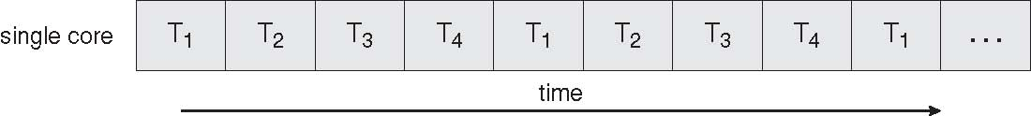
Concurrent Execution on a
Single-core System

Slide 13
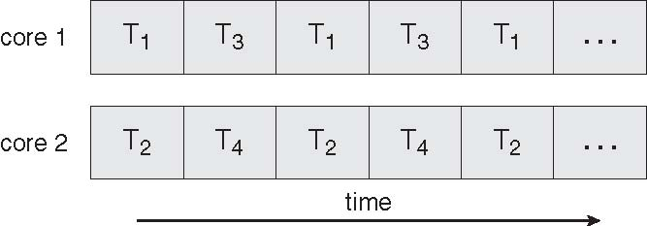
Parallel Execution on a
Multicore System

Slide 14
User Threads
Thread management done by user-level threads library

Slide 15
Kernel Threads
Supported by the Kernel
Examples
  Windows XP/2000
  Solaris
  Linux
  Tru64 UNIX
  Mac OS X

Slide 16
Multithreading Models
Many-to-One Model
One-to-One Model
Many-to-Many Model
Support for threads may be provided at the user level (user threads) or kernel level (kernel threads).

Slide 17
Many-to-One
Many user-level threads mapped to single kernel thread.
Thread management is done by the thread library in user space, so it is efficient, but entire process will block if thread makes a blocking system call.
Only one thread can access the kernel at a time so multiple threads are unable to run in parallel on multiprocessors.
Examples:
  Solaris Green Threads
  GNU Portable Threads

Slide 18
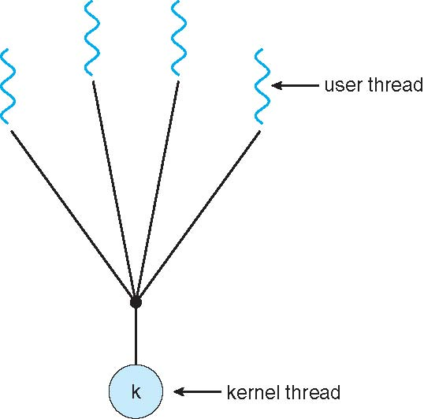
Many-to-One Model

Slide 19
One-to-One
Each user-level thread maps to kernel thread
Provides more concurrency than many-to-one model by allowing another thread to run when thread makes blocking system call.
It allows multiple threads to run in parallel on multiprocessors.
Drawback: creating a user thread requires creating corresponding kernel thread.
Examples
  Windows NT/XP/2000
  Linux
  Solaris 9 and later

Slide 20
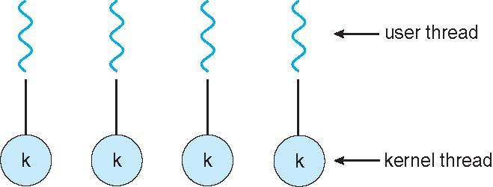
One-to-one Model

Slide 21
Many-to-Many Model
Allows many user level threads to be mapped to smaller or equal number of kernel threads
When thread makes blocking system call, kernel schedules another thread for execution.
Developer can create as many user threads as needed and corresponding kernel threads can run in parallel on multiprocessors.
Windows NT/2000 with the ThreadFiber package

Slide 22

Many-to-Many Model

Slide 23
Two-level Model
Variation of many to many model ,it allows a user thread to be bound to kernel thread
Examples
  IRIX
  HP-UX
  Tru64 UNIX
  Solaris 8 and earlier

Slide 24
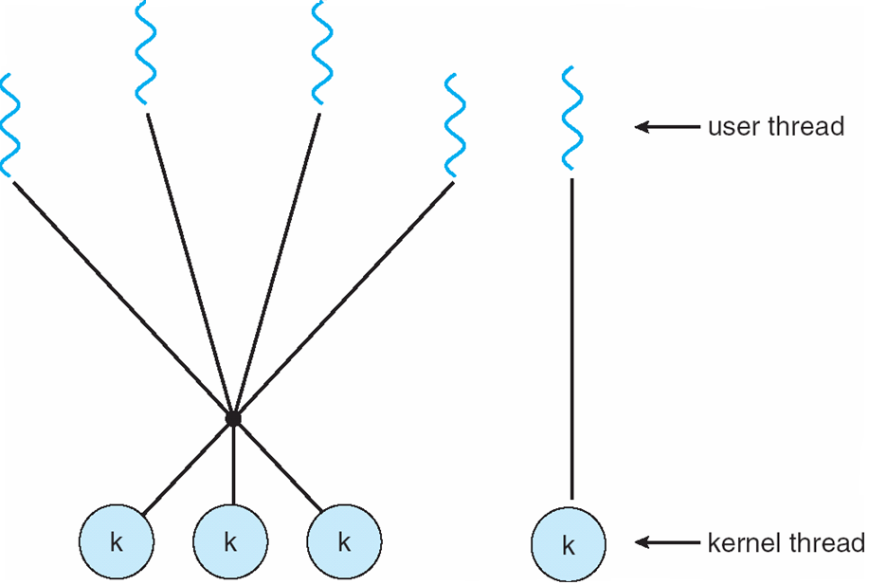
Two-level Model

Slide 25
Thread Libraries
Thread library provides programmer with API for creating and managing threads
Two primary ways of implementing
  Provide Library entirely in user space with no kernel support.(code and data are present here)
  Kernel-level library supported by the OS (code and data exist in kernel space)
Three main thread libraries:
  POSIX Pthreads
  Win32 threads
  Java threads

Slide 26
Pthreads
May be provided either as user-level or kernel-level
API specifies behavior of the thread library, implementation is up to development of the library
pThreads are available on Solaris, Linux, Mac OS X etc.
The POSIX(Portable Operating System Interface) standard ( IEEE 1003.1c ) defines the specification for pThreads, not the implementation.
Global variables are shared amongst all threads.
One thread can wait for the others to rejoin before continuing.
pThreads begin execution in a specified function.

Slide 27
Win32 threads
Threads are created in win32 API using CreateThread() function, a set of attributes for the thread is passed to this function.
These attributes include security information, size of the stack, and a flag that can be set to indicate if the thread is to start in a suspended state.

Slide 28
Java Threads
Java threads are managed by the JVM
Typically implemented using the threads model provided by underlying OS
Java threads may be created by:
  Extending Thread class
  Implementing the Runnable interface
  ALL Java programs use Threads - even "common" single-threaded ones.
  The creation of new Threads requires Objects that implement the Runnable Interface, which means they contain a method "public void run( )" .

Slide 29
Contd..
  Creating a Thread Object does not start the thread running - To do that the program must call the Thread's "start( )" method. Start( ) allocates and initializes memory for the Thread, and then calls the run( ) method.
  Because Java does not support global variables, Threads must be passed a reference to a shared Object in order to share data

Slide 30
Threading Issues
Semantics of fork() and exec() system calls
Thread cancellation of target thread
  Asynchronous or deferred
Signal handling
Thread pools
Thread-specific data
Scheduler activations

Slide 31
fork() and exec() system calls
fork() system call is used to create a separate duplicate process.
The semantics of fork() and exec() system calls changes in multithreaded program.

Slide 32
Thread Cancellation
Thread cancellation is the process of Terminating a thread before it has completed.
Eg:if multiple threads are concurrently searching through a database if one thread returns the result then remaining threads might be cancelled.
Thread that is to be cancelled is called target thread.
Cancellation of target thread may occur in two scenarios:
  Asynchronous cancellation one thread immediately terminates the target thread.
  Deferred cancellation allows the target thread to periodically check if it should be cancelled.

Slide 33
Signal Handling
Signals are used in UNIX systems to notify a process that a particular event has occurred.
It can be synchronous (divide by zero, illegal memory access) or asynchronous.
A signal handler is used to process signals
  Signal is generated by occurrence of a particular event
  Generated signal is delivered to a process
  Once delivered ,signal must be handled
Signal may be handled by one of possible handlers:
A default signal handler
A user defined signal handler

Slide 34
Contd..
Every signal has default signal handler that is run by the kernel, this default action is overridden by user defined signal handler , which is called to handle the signal.
Some signals(changing size of window) may be ignored.
Handling signals in single threaded program is straightforward, but delivering signals in multithreaded programming is complicated.
delivering signals in multithreaded programming includes following options:
  Deliver the signal to the thread to which the signal applies
  Deliver the signal to every thread in the process
  Deliver the signal to certain threads in the process
  Assign a specific thread to receive all signals for the process

Slide 35
Thread Pools
When a request comes from the client, thread is created to service that request, after servicing thread is discarded.
Suppose many requests comes from client, so many threads created to service them concurrently, thus unlimited threads may exhaust system resources like CPU, memory etc.
Solution to this is thread pool.
Idea is to create number of threads at process startup and place them in pool.
When service request comes server awakens a thread for service, after finishing service thread is passed to pool.

Slide 36
Contd..
Advantages:
  Service a request with an existing thread is faster than waiting to create a new thread
  Pool limits number of threads that exist at any one point.

Slide 37
Thread Specific Data
Threads belonging to a process share the data of process.
Eg: each transaction may be serviced in separate thread.

Slide 38
Scheduler Activations
Many systems implementing either many to many or two level model place intermediate data structure between user and kernel thread called LWP(Light Weight Process)
Each LWP is attached to kernel thread, and it is kernel threads that the operating system schedules to run on physical processors.
If kernel thread blocks(while waiting for I/O operation to complete) , the LWP blocks as well.
Up the chain the user level thread attached to the LWP also blocks.
Scheme for communication between the user thread library and the kernel is known as scheduler activation.

Slide 39
Contd..
It works as follows:
The kernel provides an application with set of virtual processors(LWPs) and application can schedule user threads onto available virtual processor.
Kernel must inform an application about certain events, this procedure is called upcall.
Upcalls are handled by the thread library with an upcall handler, and upcall handlers must run on a virtual processors.

Slide 40
Process – thread comparison
Sl no. | Thread | process
1. | A thread is the smallest unit of processing that can be performed in an OS. Single process may contain multiple threads. | A process is a computer program that is being executed. Depending on the operating system (OS), a process may be made up of multiple threads of execution that execute instructions concurrently.
2. | Thread is light weight taking lesser resources than a process. | Process is heavyweight or resource intensive.
3. | Thread switching does not need to interact with operating system. | Process switching needs interaction with operating system.
4. | All threads can share same set of open files, child processes. | In multiple processing environments each process has its own memory and file resources.

Slide 41
Contd..
Sl. No. | thread | process
5. | While one thread is blocked and waiting, second thread in the same task can run. | If one process is blocked then no other process can execute until the first process is unblocked.
6. | Multiple threaded processes use fewer resources. | Multiple processes without using threads use more resources.
7. | One thread can read, write or change another thread's data. | In multiple processes each process operates independently of the others.
8. | Threads within the same process share same address space. | Processes do not share same address space.
9. | Thread can share file descriptors | Process do not share file descriptors
10. | Threads can share signal handling | Process do not share signal handling

Slide 42
End of Chapter 4

